Slide 1
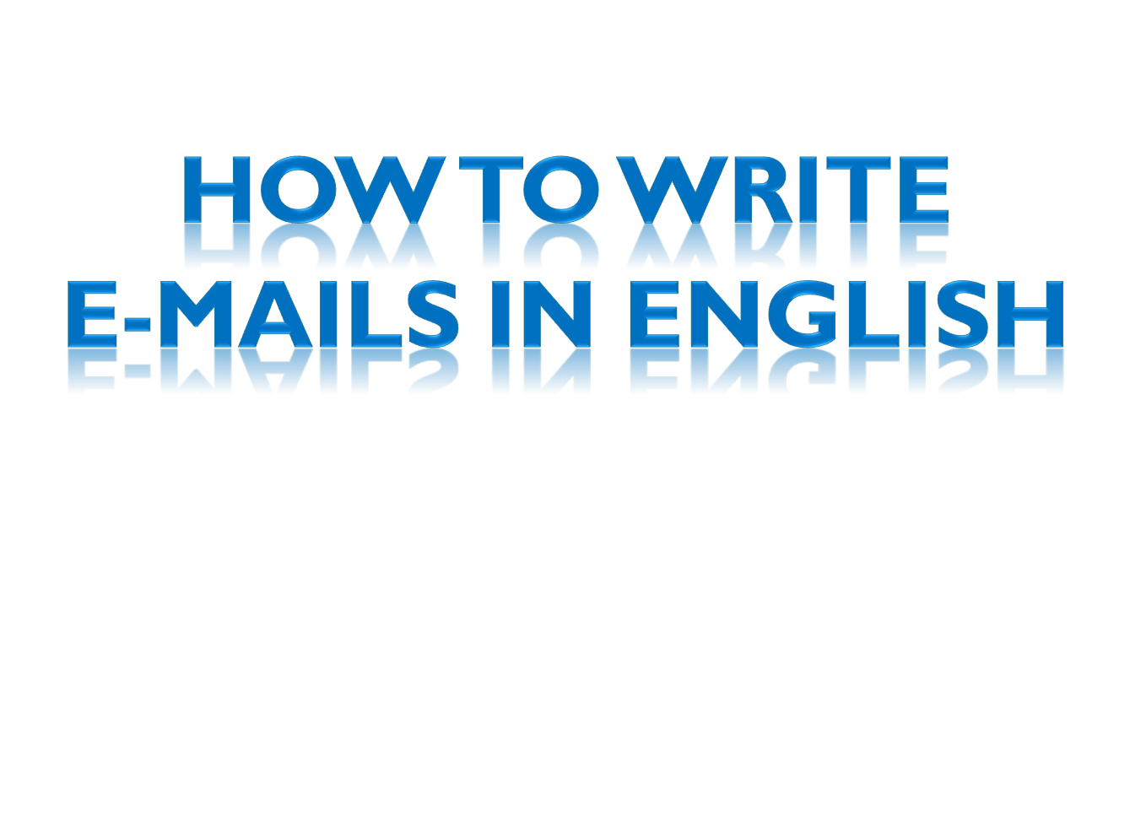


Slide 2

Usually shorter and less formal than letters, abbreviated form.
In business world, you should try to appear more formal, not too casual.
E-mails are electronic letters

Slide 3
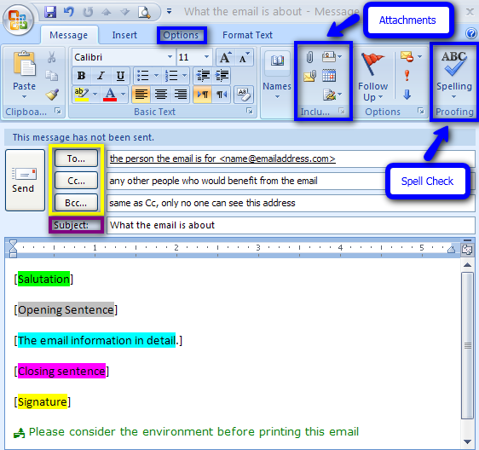



Header information
Message text
Signature

Slide 4

E-MAILS LAYOUT
Header information
It gives essential information about the message.
To
The recipient’s address (the person who you send the e-mail to)
c.c. (carbon copies)
You insert the email addresses of anyone you want to send copies of it.

Slide 5

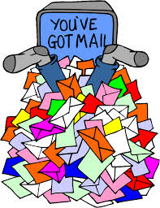
b.c.c. (blind carbon copy)
When you don’t want the recipient to know who has received copies.
Attachments
Subject
Catch reader‘s attention
Brief and specific

Slide 6

Message text
The presentation is less formal than a letter.
Avoid UPPERCASE. It seems you are shouting.
Begin with a greeting
Depending on the formality of the relationship
Dear Sir/Madam /Mr. Fox (Formal)
To Whom It May Concern (Formal)
Name (Very informal)
Hello Monica (informal)

Slide 7
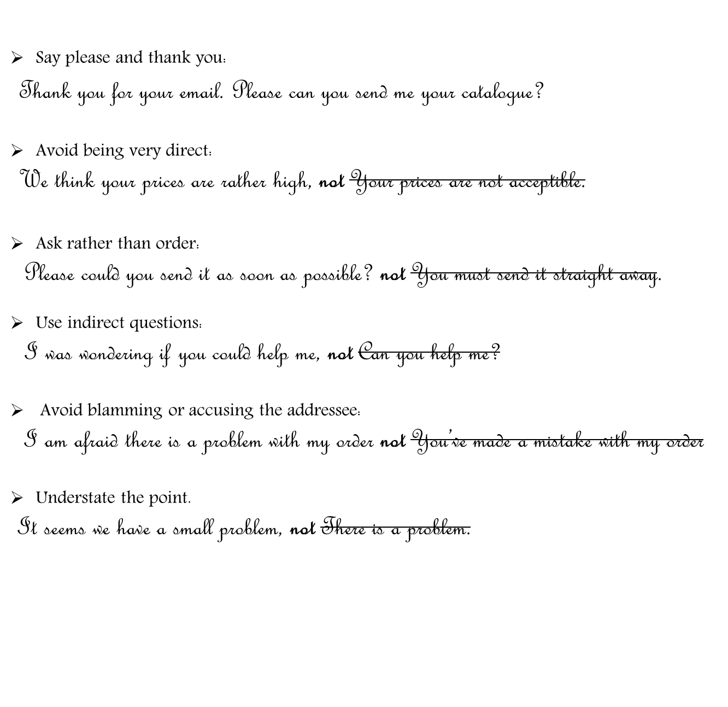
B
E
P
O
L
I
T
E
!

Slide 8
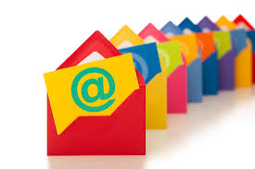
Acknowledge the recipient
Replying to client‘s inquiry
Thank you for contacting ABC company
Replying to a complaint
Thank you for contacting us with your complaint
Find anything to thank for
Thank you for your prompt reply

Slide 9

State your purpose
If you are initiating the communication make it clear early in the e-mail.
Keep sentences short and clear.
I‘m writing to enquire about / to inform you
Keep it short and to the point
Eliminate all the information that is not necessary
State the most relevant and interesting information first – people
are busy.
Short paragraphs (3-5 sentences)

Slide 10

End with a closing
Thanks again.
Refer to future contact.
Closing line: Best regards/ wishes, Yours sincerely (you know the recipient well)
.
Add your contact details.
Check your e-mail before sending it. Correct grammar, spelling mistakes and punctuation.

Slide 11
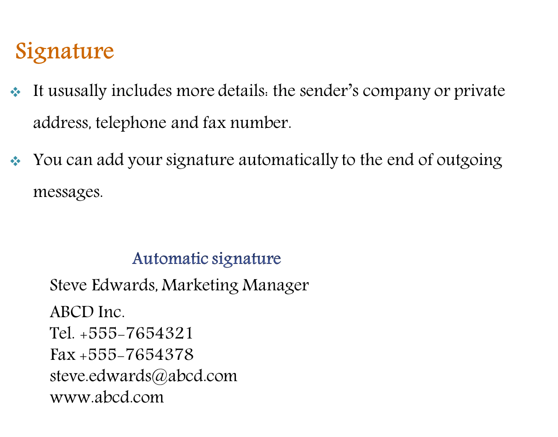
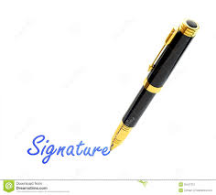

Slide 12
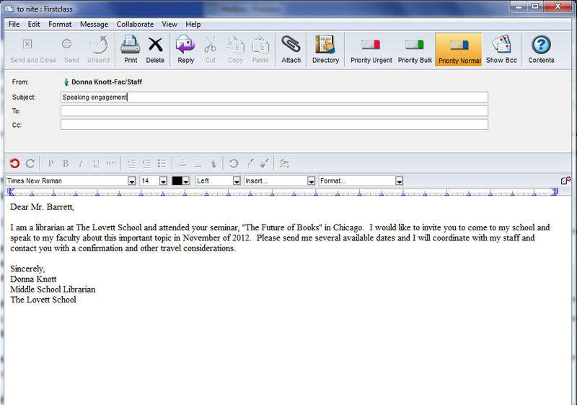
Formal E-mails

Slide 13
